Slide 1


Career Development & Career Skills
Session V: Career Exploration

Slide 2
LEARNING OBJECTIVES
By the end of this section, you will be able to:
Describe the stages of career development, and identify the stage you’re currently in
Identify career development resources in your school, community, and beyond

Slide 3
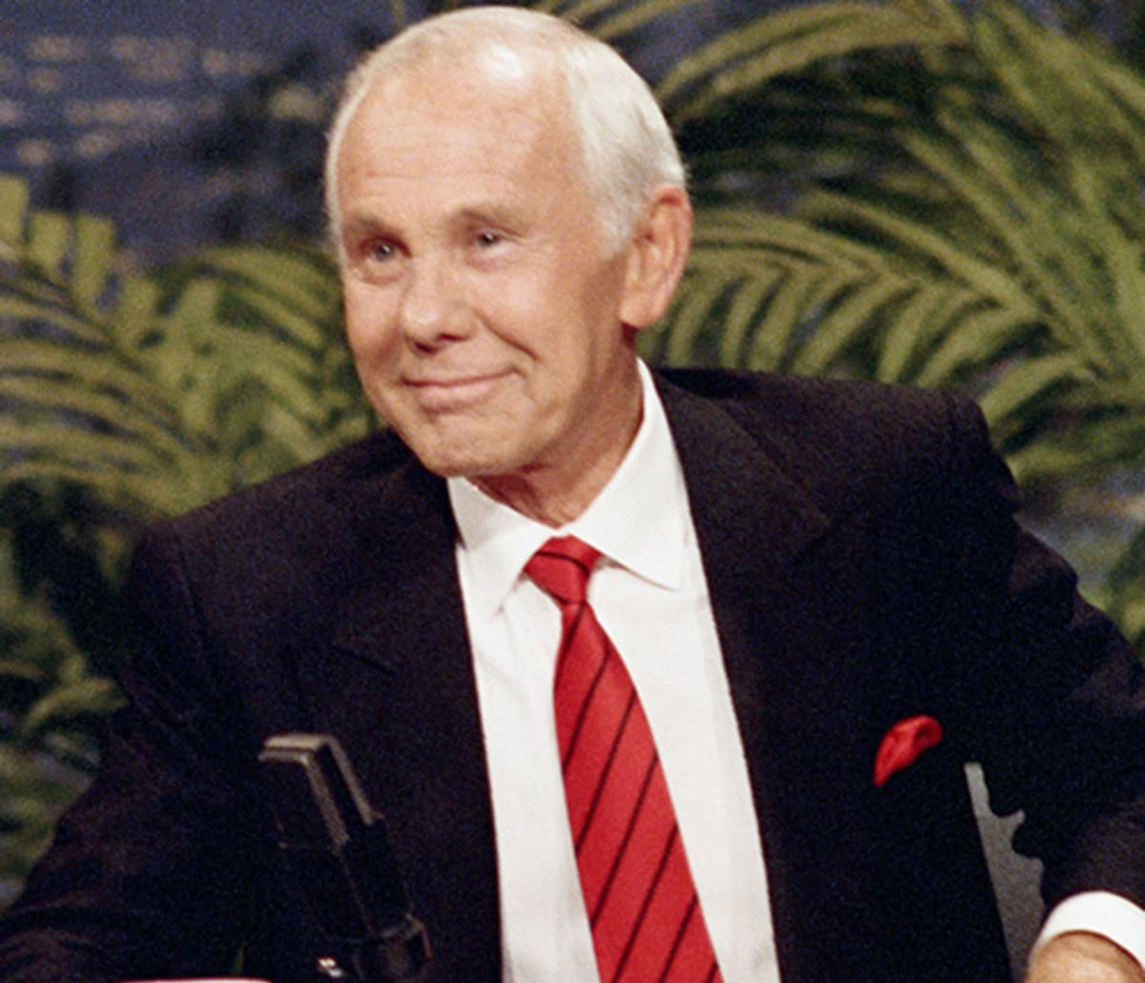
Desire! That’s the one secret of every man’s career
Johnny Carson, entertainer

Slide 4
What is Career Development?
It’s a lifelong process in which we become aware of, interested in, knowledgeable about, and skilled in a career.
It’s a key part of human development as our identity forms and our life unfolds.

Slide 5
Stages of Career Development
GROWING
EXPLORING
ESTABLISHING
MAINTAINING
REINVENTING

Slide 6

Career Roadmap
The road map identifies the following four cyclical steps:
Know yourself
Explore and choose options
Gain knowledge and experience
Put it all together: the job search process

Slide 7
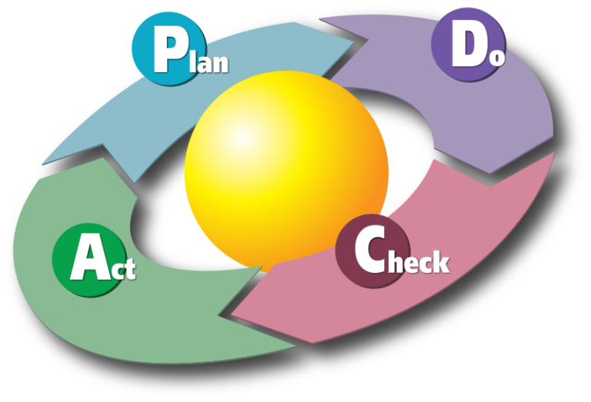
Plan, Do, Check, Act

Slide 8
PDCA (plan–do–check–act)
PLAN: What are your goals and objectives? What process will you use to get to your targets? You might want to plan smaller to begin with and test out possible effects.
DO: Implement your plan. Sell your product—which is YOU and your skills, talents, energy, and enthusiasm.
CHECK: Look at your results so far. Are you happy with your job or wherever you are in the career-development process? How is your actual accomplishment measuring up next to your intentions and wishes?
ACT: How should you act going forward? What changes in planning, doing, and checking do you want to take? The PDCA framework is an ongoing process. Keep planning, doing, checking, and acting. The goal is continuous improvement.

Slide 9

Analyzing Your Qualifications and Job Preferences
Individual profile
Education
Experience
References
Job preferences

Slide 10
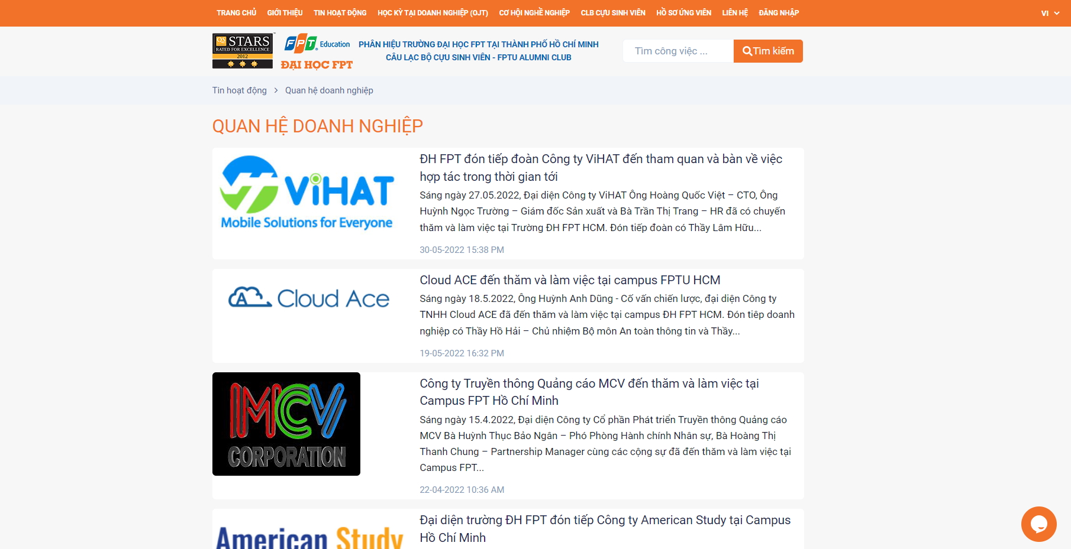
Resources for the Job Search
Campus career centers
Networking contacts
The Internet

Slide 11

Resources for the Job Search (Cont.)
Newspaper and journal advertisements
Private or government employment agencies
Web page profile
Job/career fairs

Slide 12

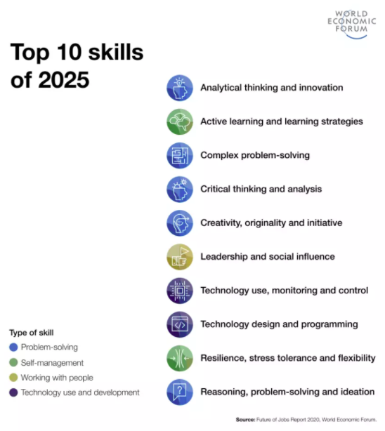
Working in the post-COVID era: Top skills for the future
Source: https://safety4sea.com/cm-working-in-the-post-covid-era-top-skills-for-the-future/

Slide 13
"To address the substantial challenges facing the labour market today, governments must pursue a holistic approach, creating active linkages and coordination between education providers, skills, workers and employers, and ensuring effective collaboration between employment agencies, regional governments and national governments.”

Slide 14
ACTIVITY: CAMPUS TO CAREER
Examine two critical questions about developing your career while still in college:
1. How do I prepare myself for a career while I’m in college?
2. How do I position myself to get ahead?

Slide 15
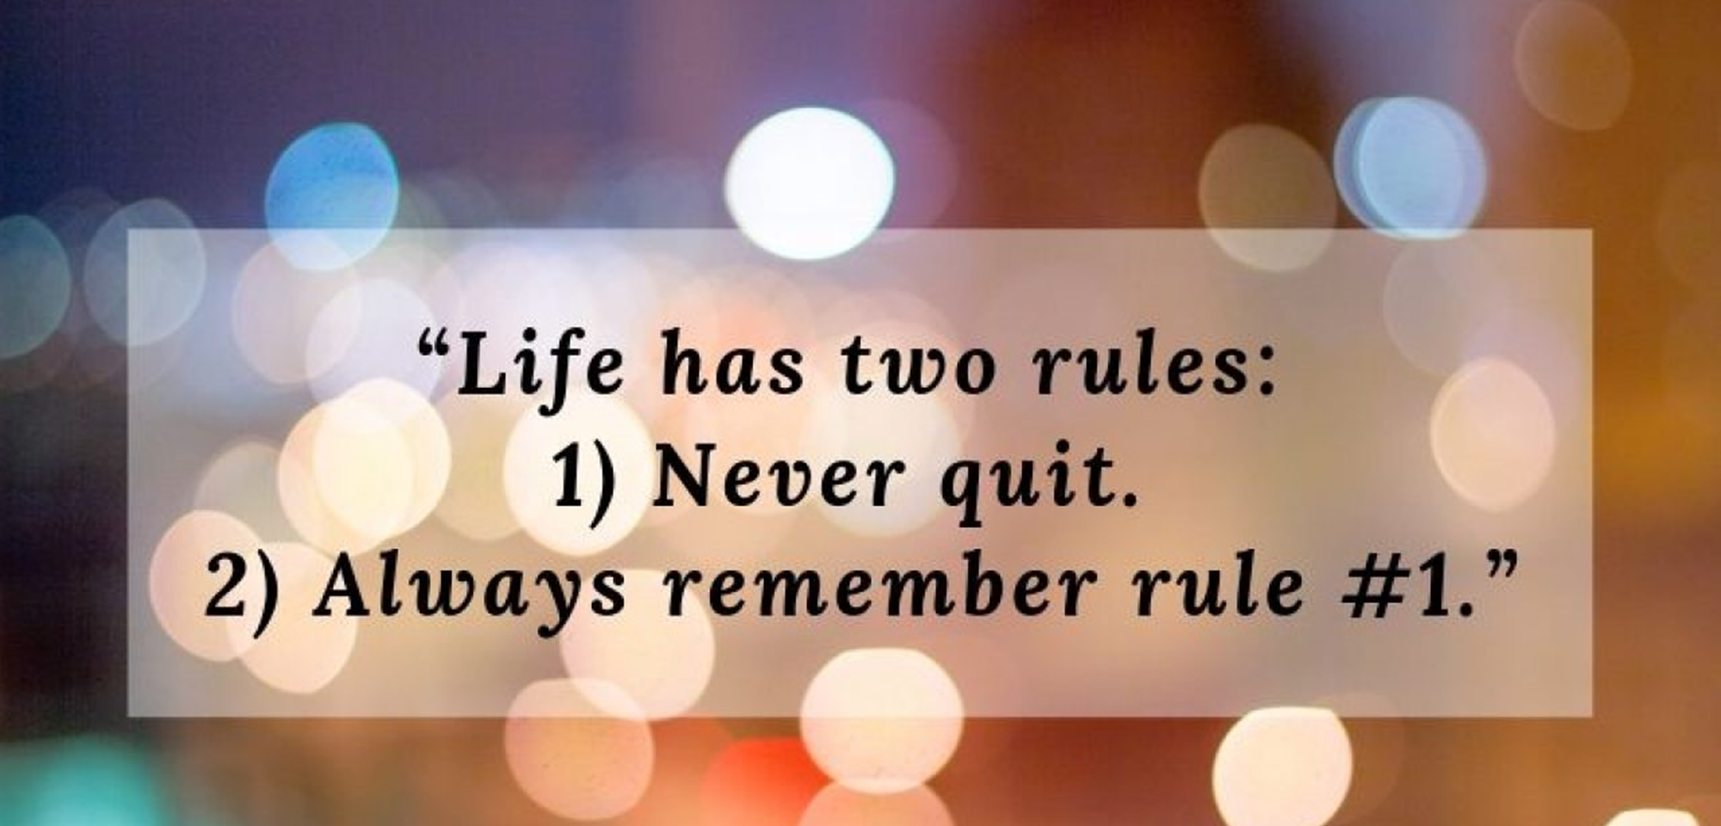

Slide 16


